Slide 1
Covid-19 Heath Workforce Estimator User Guide
Version 2.0
1st April 2020

Slide 2
What does is this HWF Estimator intended to do (1)
The HWFE tool provides an estimate, based on user data,
of the required number of each type of health worker based
on target number of mild/moderate/severe/critical patients/day.
It also provides an analysis of the throughput of mild/moderate/severe/critical patients in multiple facilities and highlights workforce gap in each type of health worker.

Slide 3
What does is this HWF Estimator intended to do (2)
In Scope
Out of Scope
Estimated workforce to care for COVID-19 patients
4 Different levels of severity; Mild, Moderate, Severe and Critical (plus 3 more if required)
User-defined healthcare facilities and work units
User-defined staff groups & workforce at each healthcare facility and work unit
Pre-populated time for staff to complete necessary procedures/activities per patient per day
Forecasting future Covid-19 cases
Skill mix/task sharing
Staff absences, e.g. from COVID-19 infections or quarantine
Higher-level staff groups, e.g. all specialists, all nurses
Representation of uncertainty
Notes:
There are several areas which are currently out of scope but may be considered for future released.
Although this is not a forecasting tool, it would be possible to link it to the output from predictive models, in terms of the number and severity of Covid-19 cases at a specific date.

Slide 4
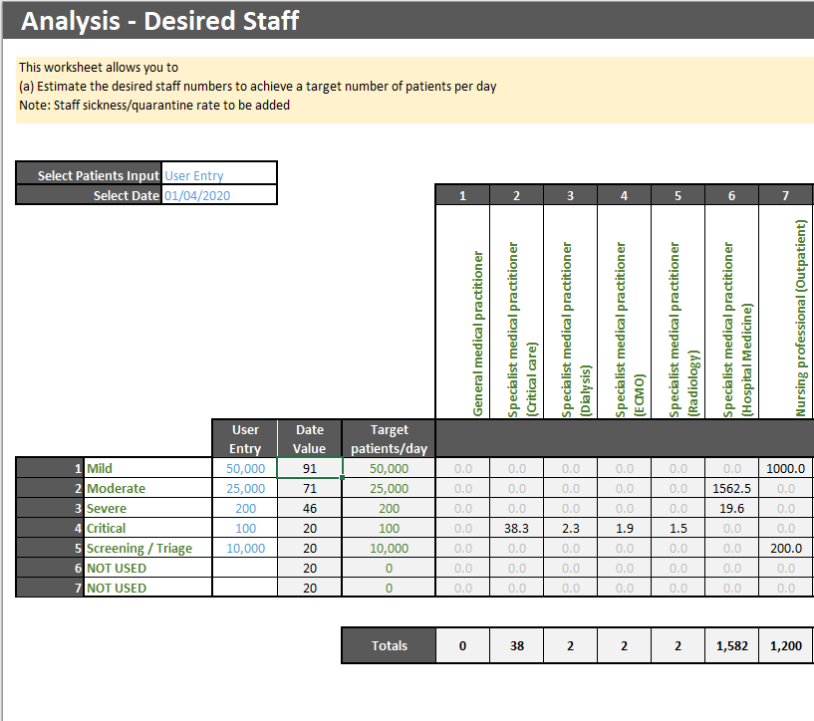
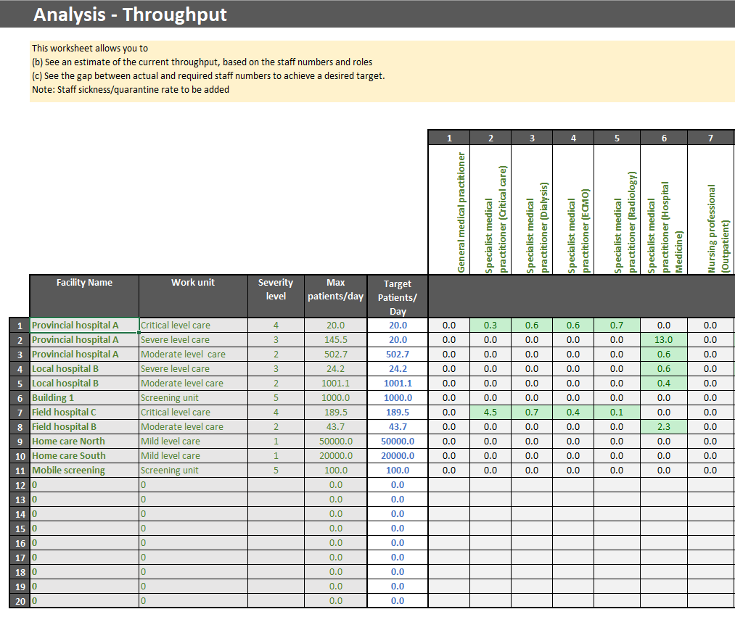
Health Workforce Estimator Tool
The tool allows you to:
Estimate the workforce needed to treat a specific number of Covid-19 cases per day (by level of severity)
Understand the maximum capacity of your existing workforce
See what workforce groups are limiting this capacity (under-supply)
See what workforce groups could be shifted (over-supply)
Understand the capability of a re-designed health workforce
Notes:
The tool provides a way to understand current and target capabilities for treating Covid-19 cases.
Depending on the numbers and skills of the available workforce, the cases that can be treated will be constrained or limited by one or more workforce groups. Increasing these numbers will allow more cases to be handled. The tool allows these workforces to be identified.
Similarly, across all the health facilities and work units, some units will be under greater pressure than others, and these can also be identified. This allows you to consider:
How staff can be re-assigned to close gaps in supply
How resources can be re-assigned to support those work units under most pressure

Slide 5
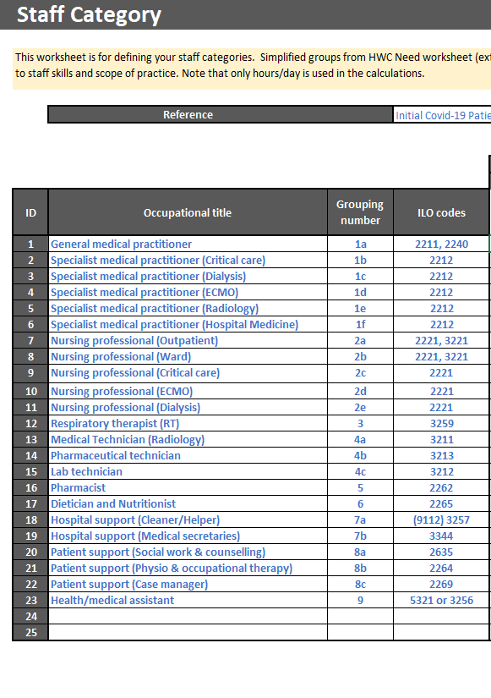
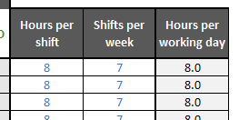
Using the tool – Data Input (1)
Start by putting in your data:
Label your staff groups in the Staff Category worksheet.
Define your allocation of staff the severity groups by hours required
Check that the allocation is correct
Notes:
The sample data in the tool can be replaced by your own data. The worksheet is protected, so only data input cells can be changed. The steps are as follows:
Descriptions of the patient care groups are in the Severity Definition worksheet. The severity names and level should not be changed.
Label your staff groups in the Staff Category worksheet (the patient times are updated in Step 3) and set the working hours. Note that Hours per working day is used in the calculations. If you are not using Shifts per week and Hours per shift, set Shifts per week to 7 and Hours per shift to the desired number of Hours per working day. Up to 25 staff groups may be created. If the staff groups skills need to be changed, then the Reference data will need to be updated accordingly. This is not recommended unless you understand the treatment of Covid-19 patients and access to supporting data. Patient time per 24hrs (green) is linked from the Reference worksheets.
We will now move in the next slide to dealing with facilities data

Slide 6
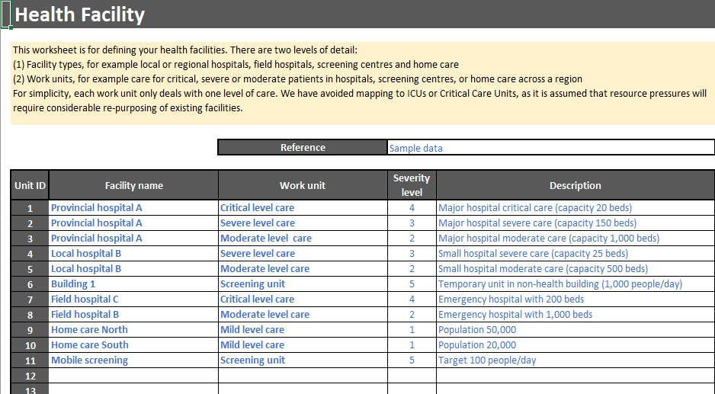
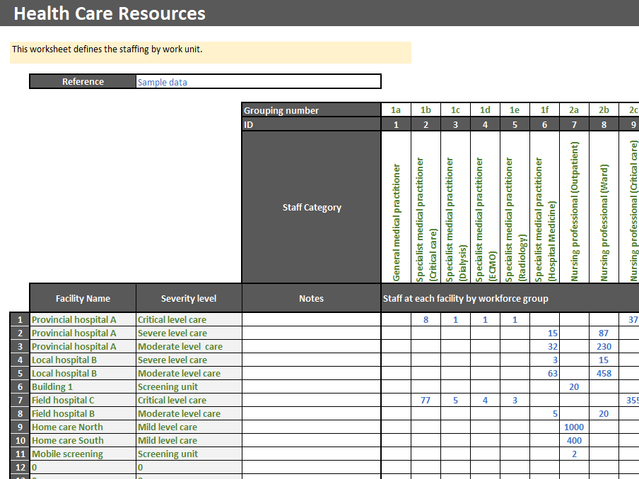
Using the tool – Data Input (2)
Entering facilities data:
Define your health facilities and work units in the Health Facility worksheet.
Define your resources in the Health Care Resources worksheet
Re-visit the Staff Categories worksheet to confirm that all data fields have been populated (previous slide)
Check that the allocation is correct
Notes:
Define your health facilities and work units in the Health Facility worksheet. Each work unit must have a severity level and is assumed to treat only these cases. Health facilities/work units may be at a country, region or city level. If more than 20 work units are required, then different versions of the tool should be created
Define your resources in the Health Care Resources worksheet. The units are in FTE (Full-Time Equivalents)
Re-visit the Staff Categories worksheet to confirm that all data fields have been populated, and revise if necessary. You should now have populated all the required fields

Slide 7
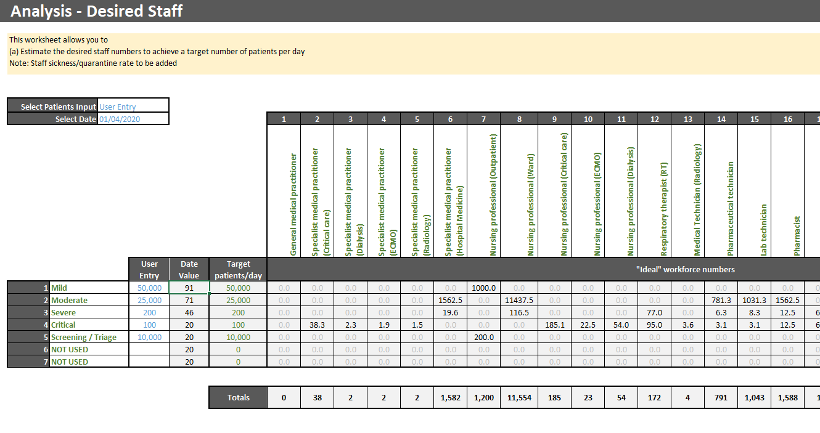
Analysis – Desired Staff worksheet
The Analysis – Desired Staff worksheet will assist to answer the question:
“What staff groups and numbers are needed to achieve a target number of Covid-19 patients per day?"
User entry will allow the user to set the patient numbers and therefore the derived workforce requirement.
From w/c 6/4/2020
Selecting Date rather than user entry will allow users to access estimated predictions in the EPI data set entered by the user, which will set the patient numbers and derive workforce requirements.
Notes:
Make sure that Select Patient Input is set to User Entry.
Input the desired value for each level of severity (1 to 4, or 5 for screening). This can be done for one or all staff groups. The table will then show the workforce numbers for each staff group, and the totals.

Slide 8
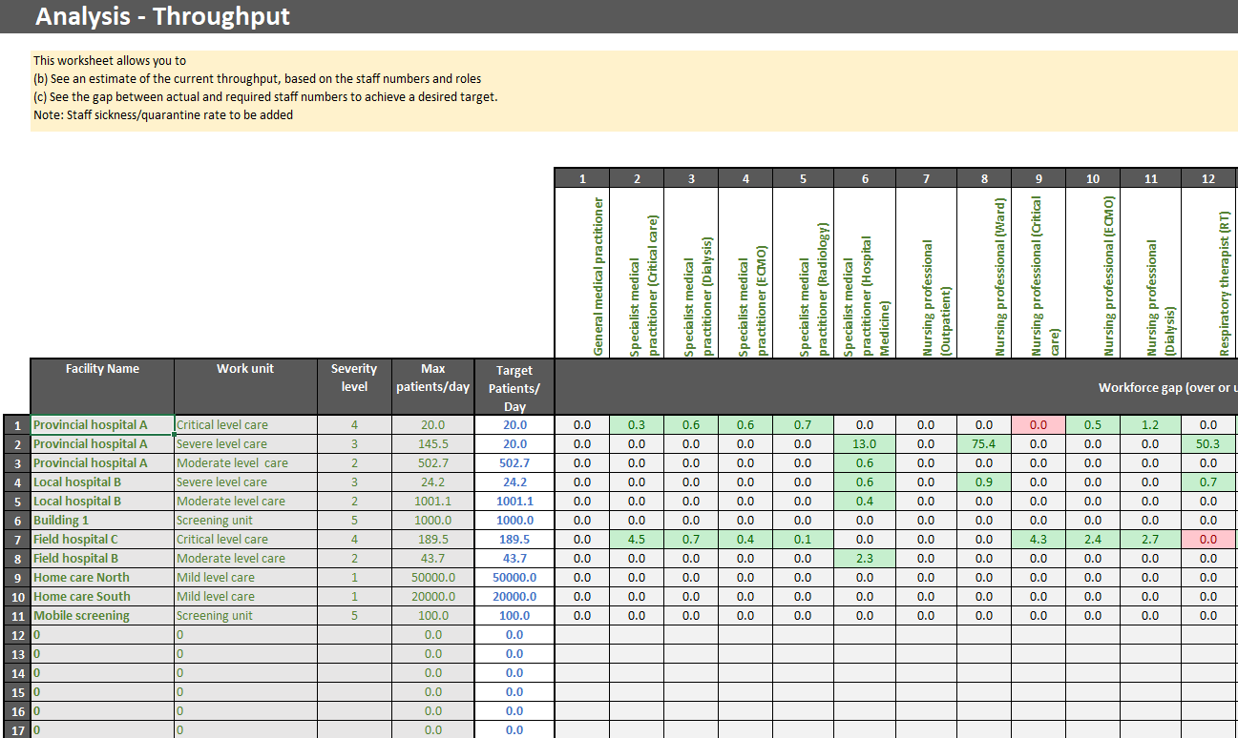
Analysis Throughput – Staff gaps
The Analysis – Throughput worksheet can answer the questions:
“What is the maximum capacity of my workforce?”, and
“What staff groups or health facilities/work units are under most pressure?”
The user should input the patient capacity of (selected) units that they are interested in.
This may vary from the maximum depending on actual utilization (greater or lesser than published capacity).
Notes:
If Target Patients/Day is set to zero, then the workforce gap table simply shows current workforce numbers.
If Target Patients/Day is set to the same value as Max patients/day, then the workforce gap table shows either zero (no under or over-supply, so this is a limiting constraint should your target go up) or green for an over-supply.
If Target Patients/Day is greater than Max patients/day, then the workforce gap table shows green for over-supply, and red for under-supply. As the target is increased, any spare workforce capacity will be used up, so eventually all workforce groups will be in under-supply, and hence red.
The summary tables at the Right and Bottom of the worksheet highlight:
which workforce groups have the largest gap, as a percentage of their workforce size and
which health facilities/work units have the largest gap, as a percentage of their workforce total.
This provides a simple way to identify potential hot spots and take action.

Slide 9
Future Updates
This version (V2.0) is being release in order to support Member States estimate the impact of a COVID-19 surge on health workforces. It is designed to be tailored by the users to suit their local environment and context within the member state setting.
It is planned that the tool will be updated and improved through its life and future changes will be implemented following use and feedback to augment functionality and improve usability.
Notes:
These updates are not prioritized and will be revised as we get user feedback and requests for change.

Slide 10
Further information
For further information please contact:
scotterc@who.int
If you have ideas for enhancements, or specific requests change, please provide the details to the contact above.

