Slide 1

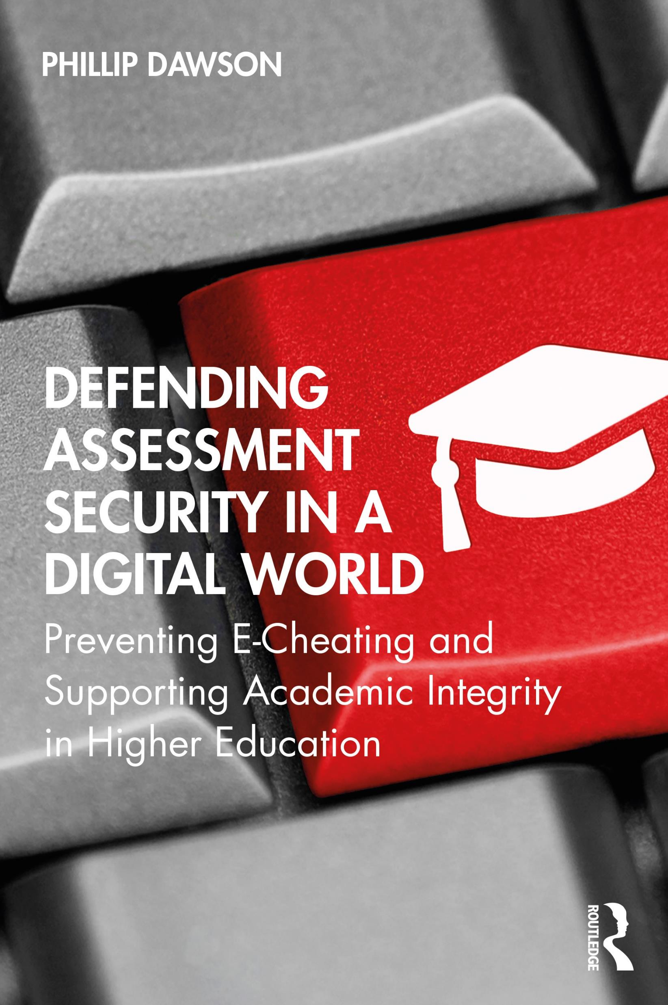
Don’t fear the robot: future-authentic assessment and generative artificial intelligence
@phillipdawson
Phillip (Phill) Dawson
Centre for Research in Assessment and Digital Learning (CRADLE)
Deakin University, Melbourne, Australia
@phillipdawson

Slide 2

Disclaimer
I’m a standards-based assessment person
I think getting this right matters because evidencing learning matters
Broader questions about genAI also matter, but they aren’t the focus here.
I don’t have an easy fix
I’m interested in long-term approaches not short-term hacks
My mum helped me cheat in grade 4

Slide 3

Three things to take from this presentation
GenAI can do a lot of what we currently assess
We probably can’t and shouldn’t ban it
Assessment needs to prepare students for their future, not our past
@phillipdawson

Slide 4
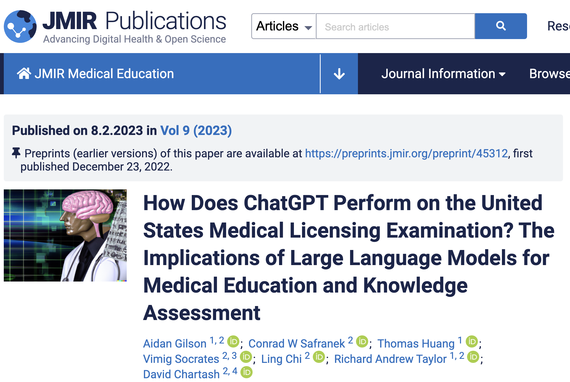
“By performing at a greater than 60% threshold on the NBME-Free-Step-1 data set, we show that the model achieves the equivalent of a passing score for a third-year medical student.”

Slide 5
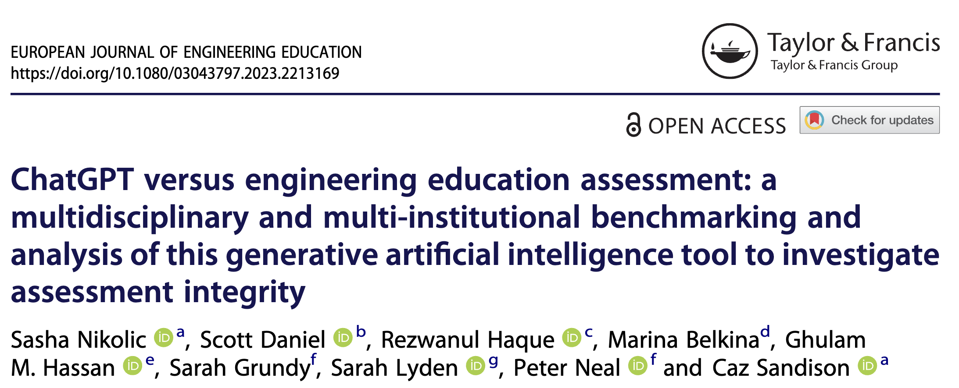

Slide 6
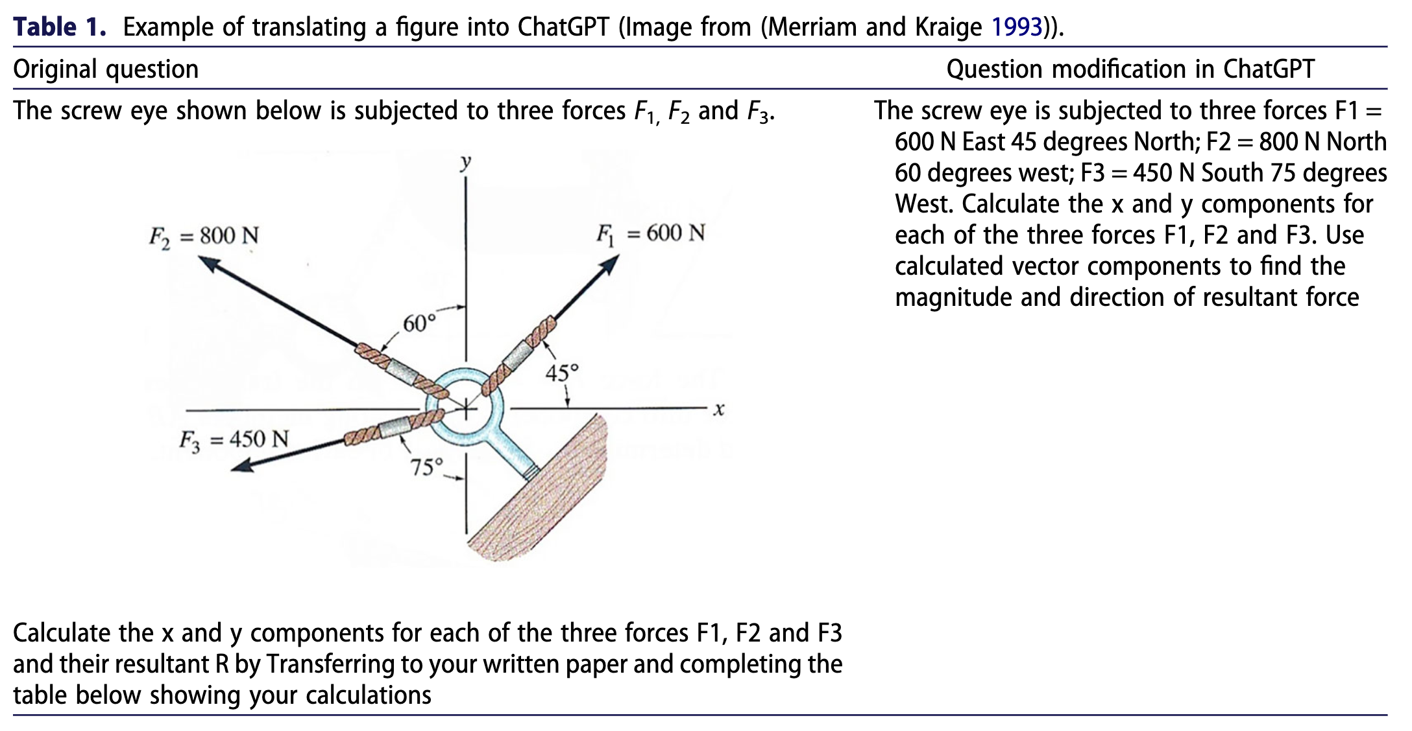

Slide 7

GPT-4, why is this meme funny?
This meme is a joke that combines two unrelated things: pictures of the earth from space and chicken nuggets. The text of the meme suggests that the image below is a beautiful picture of the earth from space. However, the image is actually of chicken nuggets arranged to vaguely resemble a map of the world. The humor in this meme comes from the unexpected juxtaposition of the text and the image. The text sets up an expectation of a majestic image of the earth, but the image is actually something mundane and silly
Liu, H., Li, C., Wu, Q., & Lee, Y. J. (2023). Visual instruction tuning. arXiv preprint arXiv:2304.08485.

Slide 8
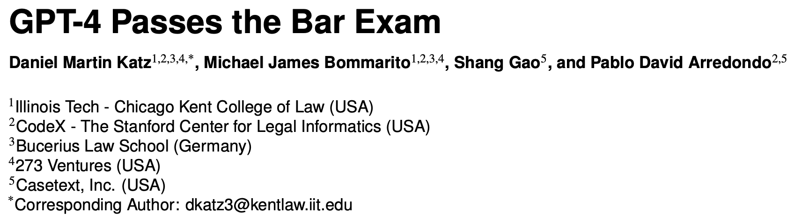

Slide 9
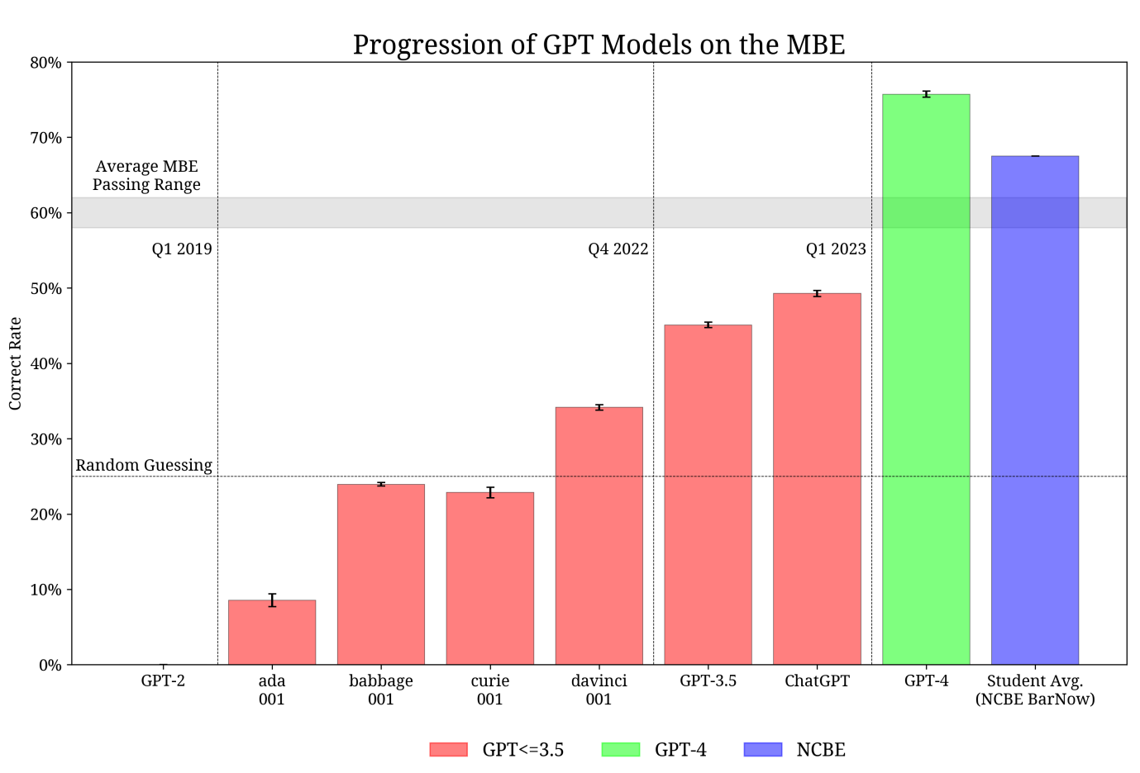

Slide 10
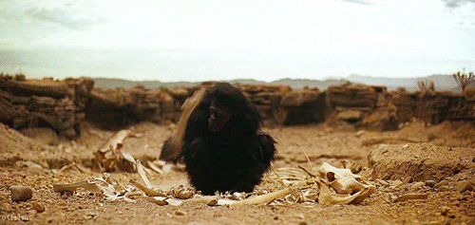
GenAI is currently the least capable it will ever be
https://giphy.com/channel/gifodyssey

Slide 11
Three things to take from this presentation
GenAI can do a lot of what we currently assess
We probably can’t and shouldn’t ban it
Assessment needs to prepare students for their future, not our past
@phillipdawson

Slide 12

Banning GenAI in educational settings
A ban is a type of restriction
Restrictions that don’t work are theatre
How do we enforce GenAI restrictions?

Slide 13
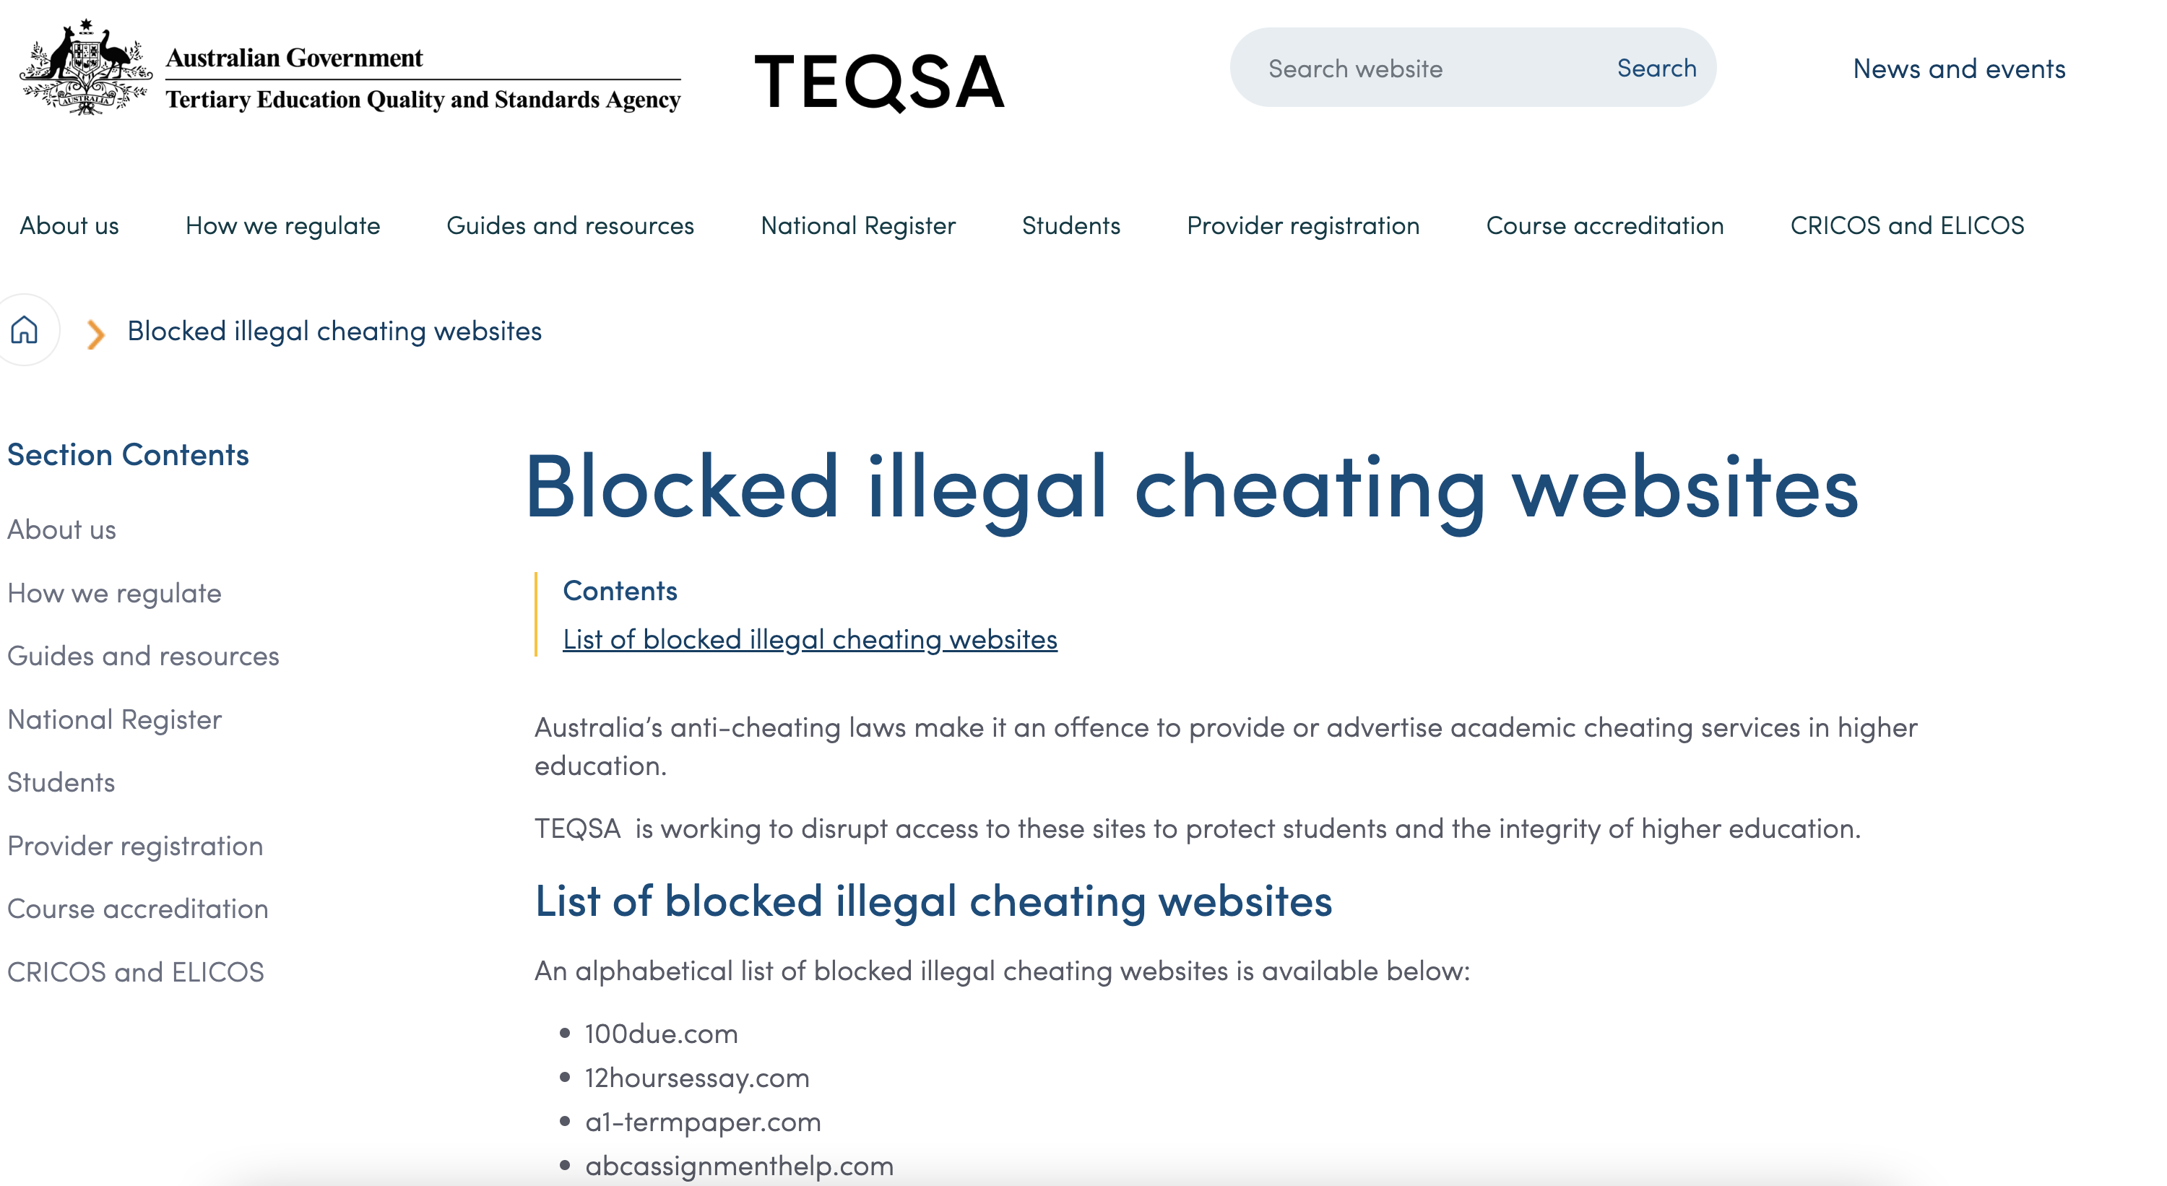
Restricting access to GenAI
In Australia, federal legislation allows site blocking for contract cheating sites. 200 are blocked at a national level.
Many institutions block contract cheating sites.
How effective are these blocks?

Slide 14

Detecting GenAI
Unclear how effective GenAI detectors are
Claims of very high detection rates haven’t been verified by independent researchers
Claims that GenAI detection won’t be possible in long term
If you take one thing from this talk: don’t upload student work to random GitHub/HuggingFace ChatGPT detectors or ChatGPT itself

Slide 15
Three things to take from this presentation
GenAI can do a lot of what we currently assess
We probably can’t and shouldn’t ban it
Assessment needs to prepare students for their future, not our past
@phillipdawson

Slide 16
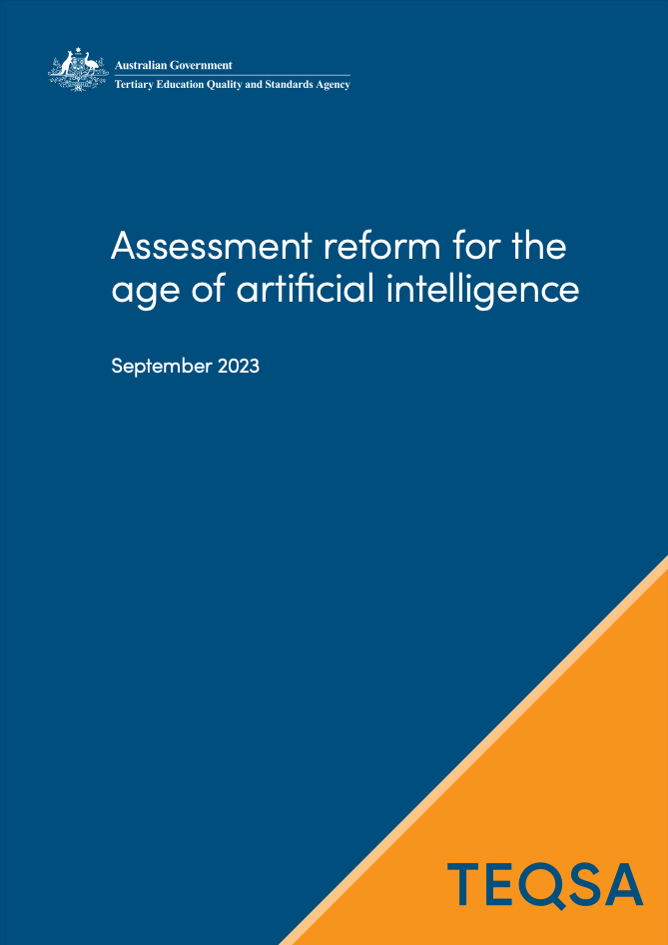
Lodge, Howard, Bearman, Dawson & Associates (2013)
2 principles
5 propositions
Developed with 18 experts in assessment, higher education and artificial intelligence
Lodge, J. M., Howard, S., Bearman, M., Dawson, P, & Associates (2023). Assessment reform for the age of Artificial Intelligence. Tertiary Education Quality and Standards Agency.
Currently published in draft form
https://www.teqsa.gov.au/guides-resources/resources/corporate-publications/assessment-reform-age-artificial-intelligence
(or Google TEQSA and the document name)

Slide 17
Two guiding principles
Guiding Principle 1
Assessment and learning experiences equip students to participate ethically and actively in a society pervaded with AI.
Guiding Principle 2
Forming trustworthy judgements about student learning in a time of AI requires multiple, inclusive and contextualised approaches to assessment.

Slide 18
Five propositions:
Assessment should emphasise…
appropriate, authentic engagement with AI
a programmatic/systemic approach aligned with discipline and qualification values
the process of learning
opportunities for students to work appropriately with each other and AI
security at meaningful points across a program to inform decisions about progression and completion

Slide 19
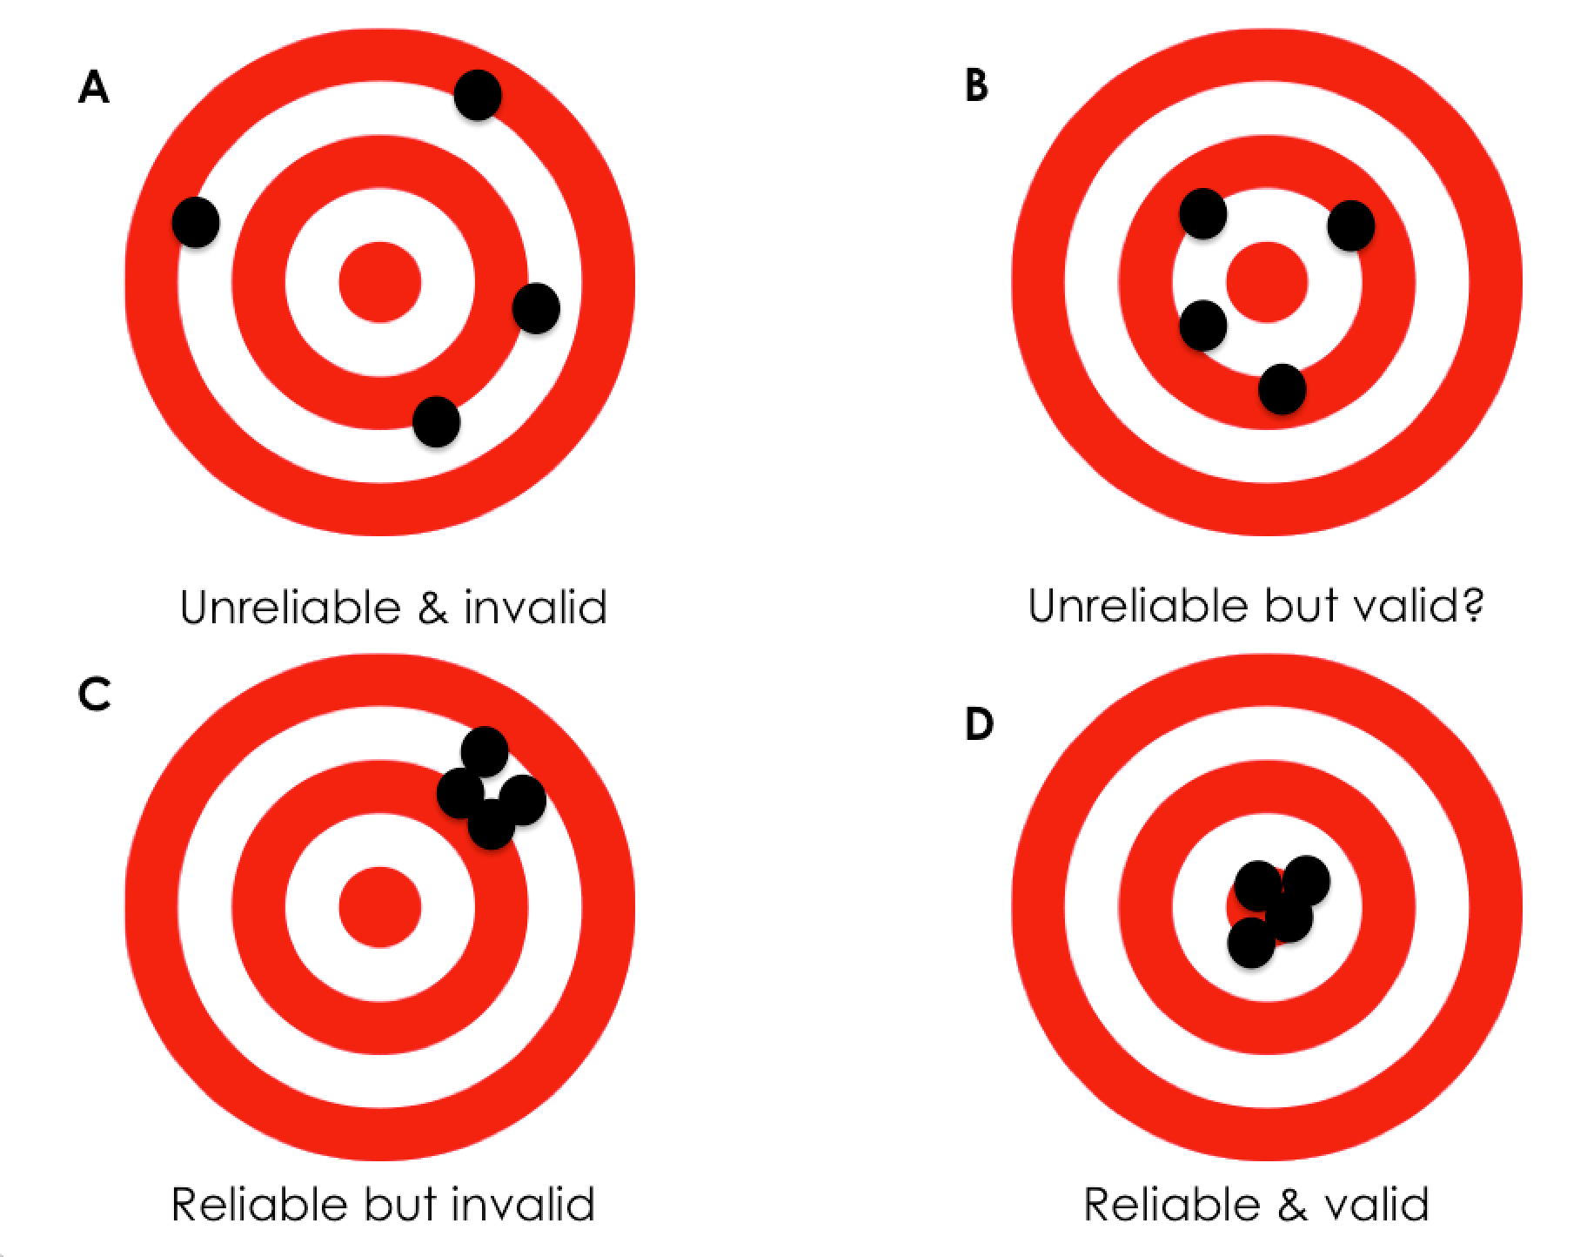
Through a validity lens
Don’t be scared of validity!
GenAI is a secondary concern to validity
Restrictions that can’t be enforced hurt validity
Exclusion hurts validity
Cheating hurts validity
Image: https://learningspy.co.uk/assessment/when-assessment-fails/#post/0

Slide 20
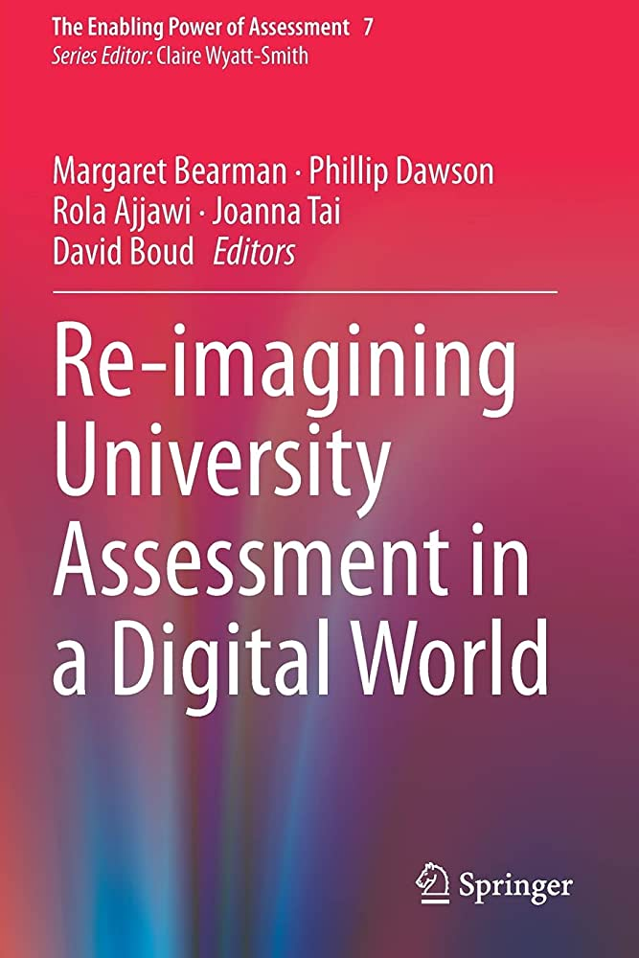
Future-authentic assessment
“assessment that faithfully represents not just the current realities of the discipline in practice, but the likely future realities of that discipline”
Dawson, P., & Bearman, M. (2020). Concluding Comments: Reimagining University Assessment in a Digital World. In M. Bearman, P. Dawson, R. Ajjawi, J. Tai, & D. Boud (Eds.), Re-imagining University Assessment in a Digital World (pp. 291-296). Springer International Publishing. https://doi.org/10.1007/978-3-030-41956-1_20

Slide 21

When do we allow genAI in assessment?
  Every time?
  As a scaffold?
  As a reverse scaffold?
  When it’s authentic?
  When it doesn’t get in the way of assessing the outcomes?
  When it enhances assessing the outcomes?
  When we can’t stop it from being used?
  Never?

Slide 22
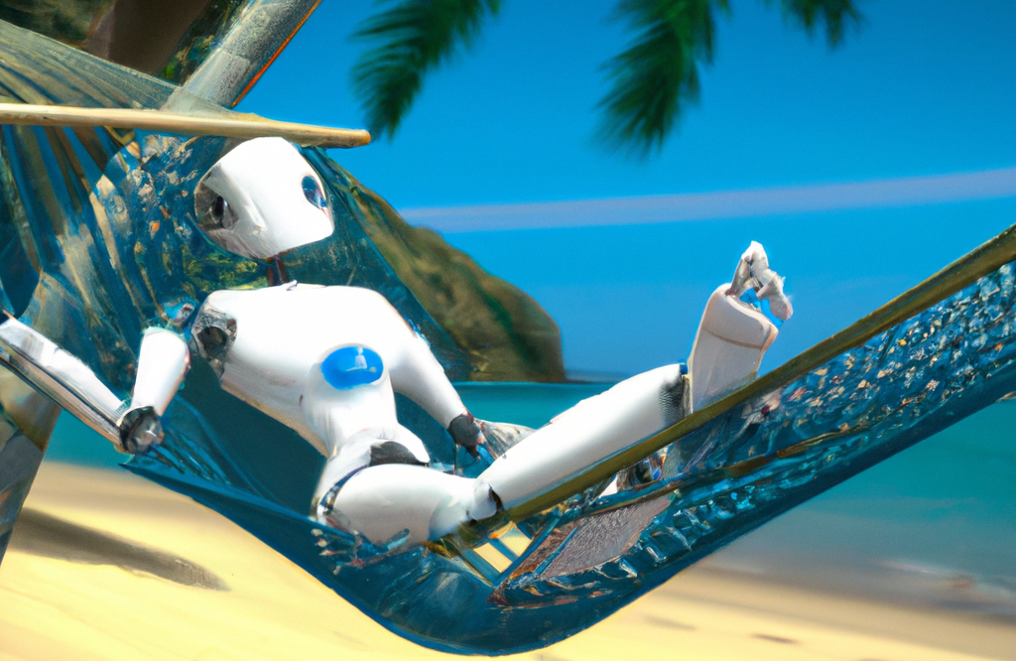
Cognitive offloading

Slide 23
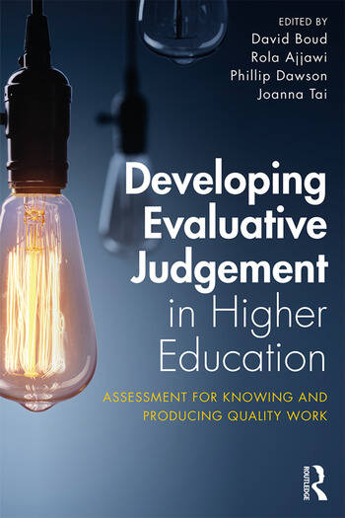
Evaluative judgement
Making judgements about quality of work
Constituting standards
Bearman, M., & Luckin, R. (2020). Preparing university assessment for a world with AI: Tasks for human intelligence. In M. Bearman, P. Dawson, R. Ajjawi, J. Tai, & D. Boud (Eds.), Re-imagining University Assessment in a Digital World. Springer.

Slide 24
Three things to take from this presentation
GenAI can do a lot of what we currently assess
We probably can’t and shouldn’t ban it
Assessment needs to prepare students for their future, not our past
@phillipdawson

