Slide 1
Mapper Prototype
Coalescing and other HCI features
Divye Kapoor
4th Year
B.Tech (IDD) CSI
IIT Roorkee
E-mail: divyeuec@iitr.ernet.in

Slide 2
Internship Details
Software Development Engineer (SDE) – Intern
May 18, 2009 – July 10, 2009
(8 Weeks)
Kishan Peyetti
Manager
Srinivas Tirupati
Mentor

Slide 3
Content Structure
About the Company
Background Information
Problem Statement
Solution
Other Work Done
Learning from the Internship
References

Slide 4
Content Structure
About the Company
Background Information
Problem Statement
Solution
Other Work Done
Learning from the Internship
References

Slide 5
DevTools group
BizTalk Server is Microsoft’s Integration and Connectivity server solution for enterprises

Slide 6
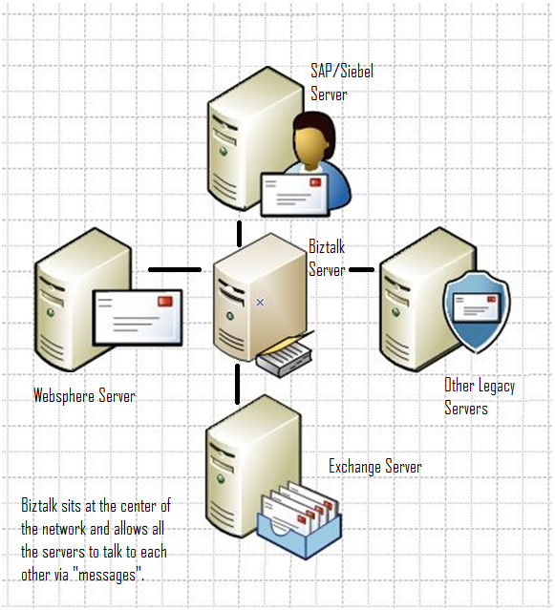
Brief Overview

Slide 7
DevTools group
BizTalk Server is Microsoft’s Integration and Connectivity server solution for enterprises
Who uses Biztalk?
A very long list. Banks, Book Stores, Fortune 500 companies… invariably they have global presence and a large set of legacy applications.

Slide 8
DevTools group
The Developer Tools division is a part of the 7 feature teams comprising Biztalk and it builds tools that enable Biztalk customers to develop and deploy Biztalk applications.
The developer tools revolve around Visual Studio.
Pipeline Editor
Schema Editor
Mapper
Orchestration Designer
VS Project System

Slide 9
Internal Structure
Orchestration
XML Message
Receive Port
Send Port
Receive
Adapter
Receive Pipeline
Data Mapping
Data Mapping
Send
Pipeline
Send
Adapter
XML Message
XML Message
Incoming
Message
Subscriptions
Outgoing
Message
Message Box
Message Path
Notes:
Biztalk server is a message transformation and routing engine.

Slide 10
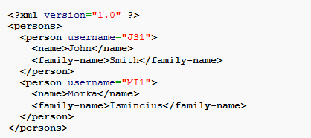
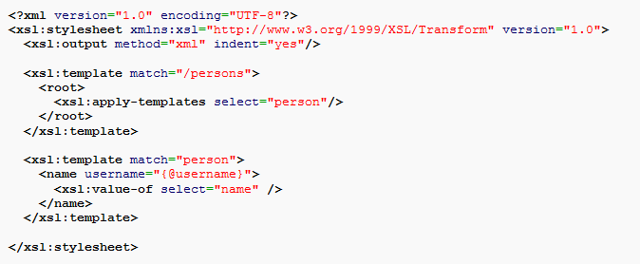
Quick Refresher
XML
XSLT
New XML
XSLT
XML
Extensible Markup Language
Extensible Stylesheet Language Transformations
Notes:
Mapping process using XSLT

Slide 11
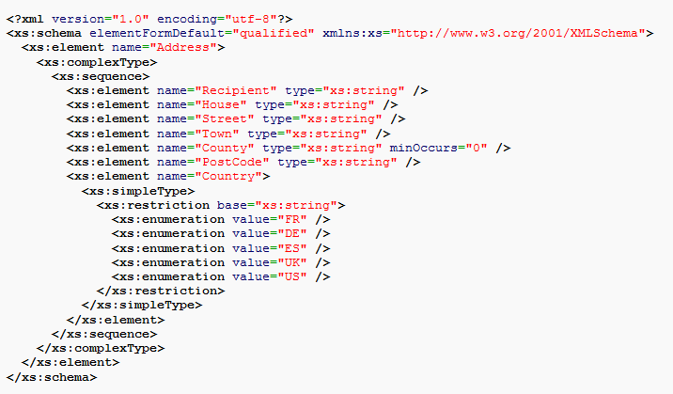
Quick Refresher
Describe the general structure of XML using an XML Schema Document (XSD) file.
Given such a generic description of the input file, it is possible to generate transformations that will work correctly as long as any XML file conforms to the expected input format.

Slide 12
Content Structure
About the Company
Background Information
Problem
Solution
Other Work Done
Learning from the Internship
References

Slide 13
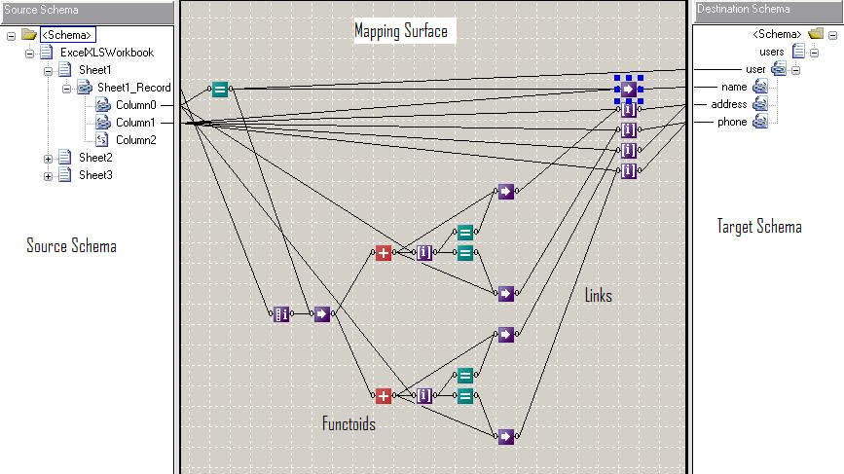
The Mapper
The Mapper compiles the mapping to XSLT
Notes:
Schema Nodes
Functoids
Links
Maps

Slide 14
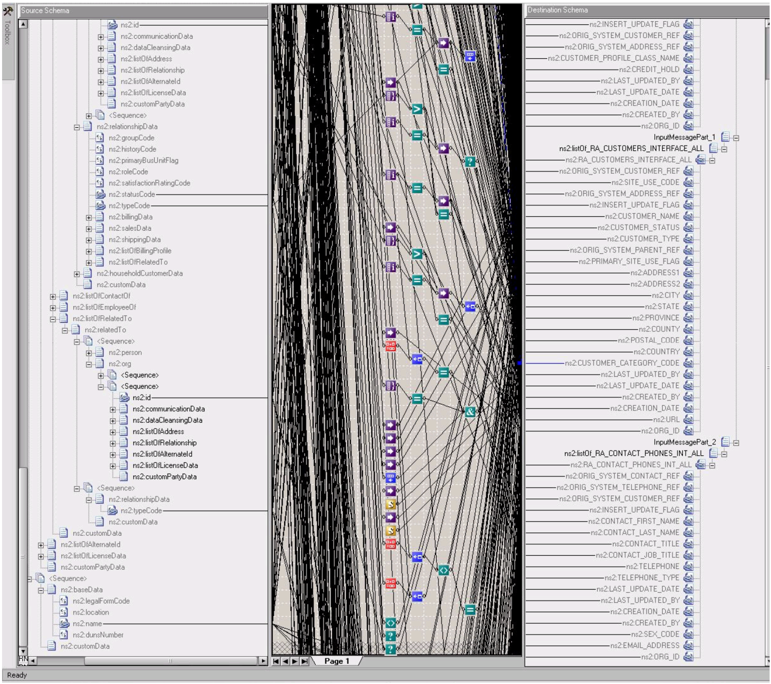
So, what’s the problem?
Notes:
The UI is the biggest challenge being faced by the Mapper.

Slide 15
Content Structure
About the Company
Background Information
Problem Statement
The Solution
Other Work Done
Learning from the Internship
References

Slide 16
How is it solved?
Multi-Select
Incremental Search
Auto-Scrolling
Highlight Propagation
Coalescing Trees
Visualization of Mappings Between Schemas^{[1]}
George G. Robertson, Mary P. Czerwinski, John E. Churchill.
Microsoft Research

Slide 17
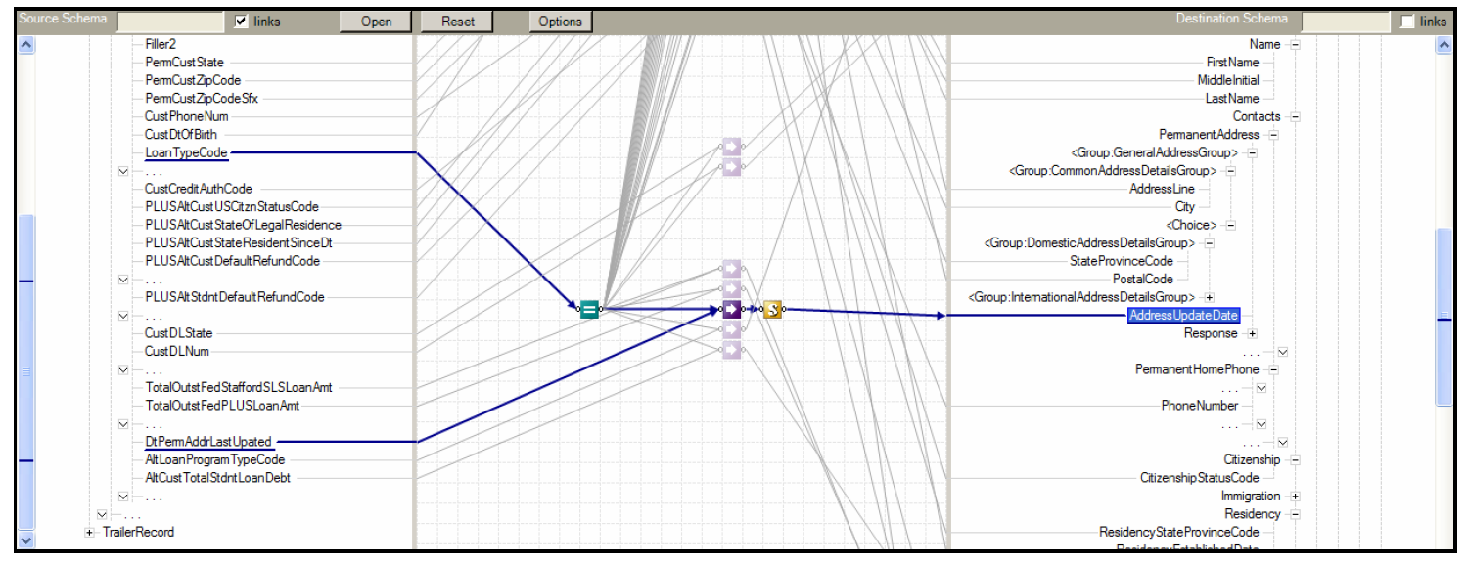
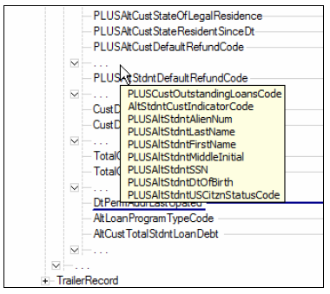
What does coalescing look like?

Slide 18
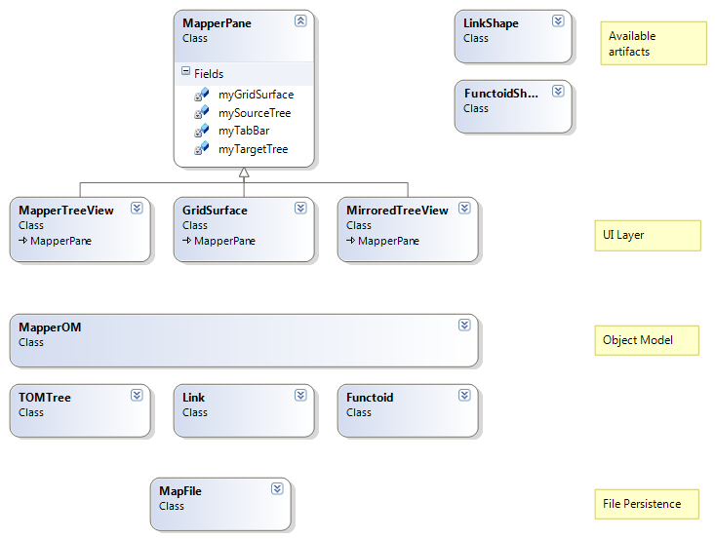
Mapper Architecture
Notes:
12000 lines of C# code. Over 30 separate classes

Slide 19
Mapper Architecture
12000 lines of C# code – written over a 5 year period
30 major classes (most elided for readability)
3 - Layered architecture

Slide 20
Mapper Architecture
Notes:
12000 lines of C# code. Over 30 separate classes

Slide 21
Mapper Architecture
Notes:
12000 lines of C# code. Over 30 separate classes

Slide 22
Mapper Architecture
Notes:
12000 lines of C# code. Over 30 separate classes

Slide 23
MapperPane
GridSurface
MapperTreeView
(customization of the .NET TreeView Control)
MirroredTreeView
(customization of the .NET TreeView Control)

Slide 24
Coalescing Implementation
Applied to the MapperTreeView and MirroredTreeView
Is a pure UI operation and doesn’t affect the underlying schemas
When applied to an unchanging map:
Static Coalescing
When applied during linking/unlinking process:
Dynamic Coalescing
TreeNodes may be collapsed or coalesced.
Collapse criteria for TreeNodes:
The schema node and all its children are unlinked.
Coalescing criteria for TreeNodes:
The node and all its child nodes are unlinked.
The node is part of a contiguous sequence of 2 or more such nodes at the same depth in the tree view.
There exists atleast 1 sibling node which is linked or which has linked children, thus preventing a collapse of the parent TreeNode

Slide 25
The Algorithm – Static Coalescing
Examine the schema nodes in the tree structure
Be aware of lazy loading of schema nodes
Determine which schema node hierarchies don’t have links or linked children and collapse them.
For other hierarchical nodes, determine which child nodes can be coalesced (unlinked with no linked children)
For nodes that meet coalescing criteria, create the special coalescing node, move the child nodes into them and collapse that node.
Hijack the expansion method to prevent expansion “in-depth ”
Prevent linking of these new coalescing nodes.

Slide 26
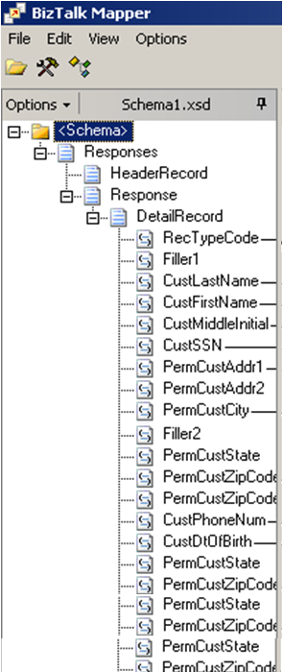
Static Coalescing
Node Insertion
Custom Drawn Node
Custom Drawing with GDI+

Slide 27
Static Coalescing Node Management
Hit Testing
Expansion/Contraction Hijacking
Linking prevention

Slide 28
Dynamic Coalescing Implementation Details
Modify the Mapper UI code to raise events on Node Addition, Deletion.
Modify the MapperOM to raise events on Schema Node Linking and Unlinking.
Attach delegates to these events.
In the event handlers:
Node Linking: Apply appropriate tree structure modifications
Node Unlinking: Revert to the state that should have come had the node not been linked in the first place
Notes:
* Denotes a heavy simplification

Slide 29
Dynamic Coalescing

Slide 30
The enormous increase in the relevance of information presented is apparent.

Slide 32
Coalescing Propagation

Slide 33
Overall
There are a total of 12 different scenarios for a linking operation.
Each of these 12 scenarios corresponds to a different set of conditions in the unlinking scenario.
Coalescing code had to handle all of them
Other features that had to be handled:
Auto-Mapping
Dynamic Page Changing

Slide 34
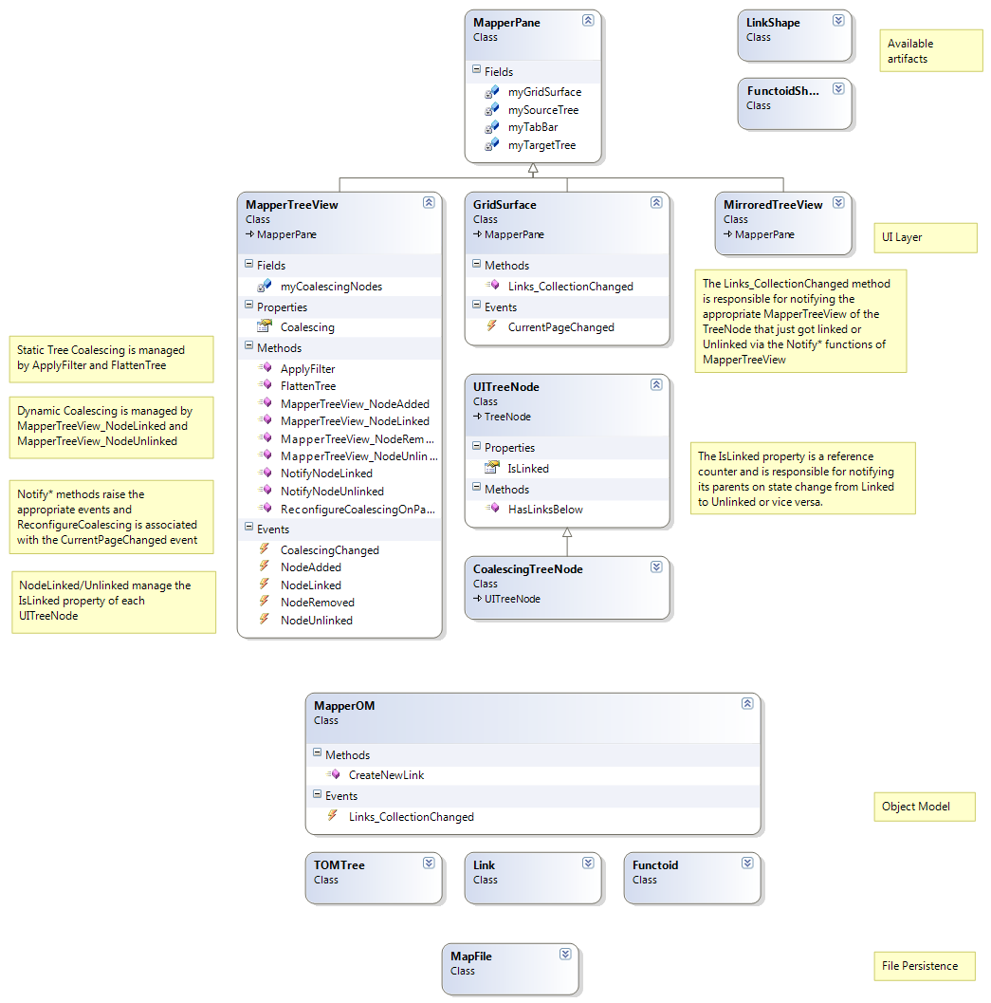
Coalescing code structure

Slide 35
Content Structure
About the Company
Background Information
Problem Statement
The Solution
Other Work Done
Learning from the Internship
References

Slide 36
Other Work Done
Ensuring consistency between the UI representation and the Mapper OM representation.
Copy-Paste functionality (with Zoom-Out free-space searching)
I also found and reported a bug in the .NET framework’s TreeView Control during the course of my implementation. It is expected to be fixed soon.

Slide 37
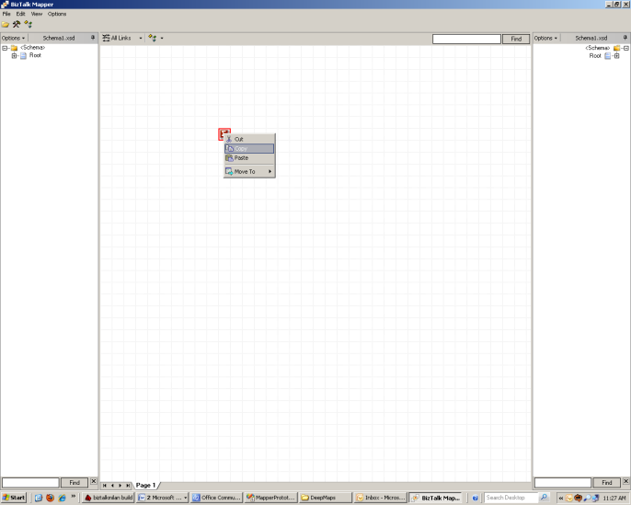

Slide 38
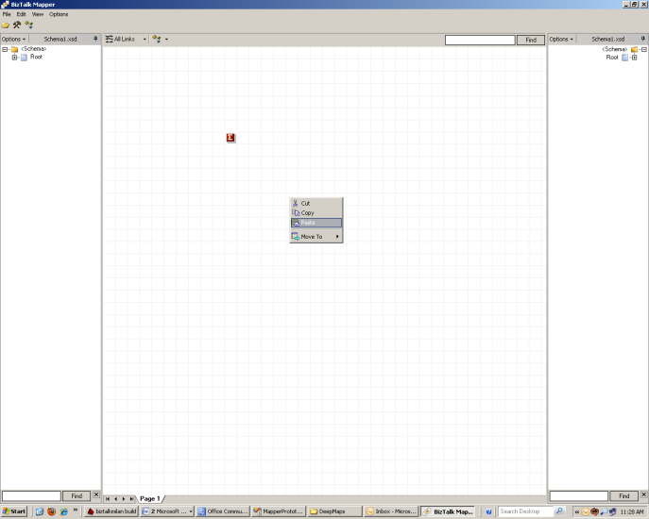

Slide 39
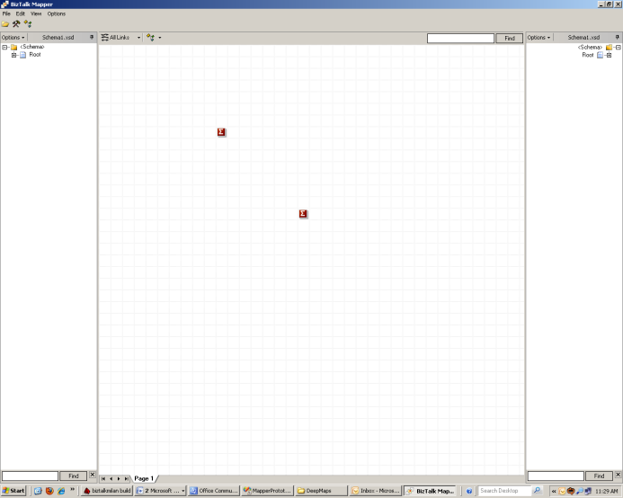

Slide 40
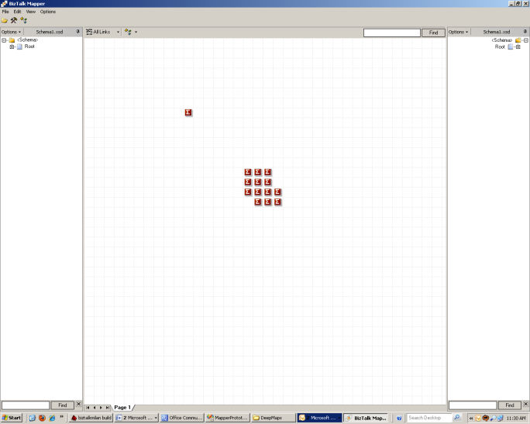
Zoom Out Search
Notes:
The paste code starts searching from the last clicked location, spiralling outwards till it finds a free square to put it in.

Slide 41
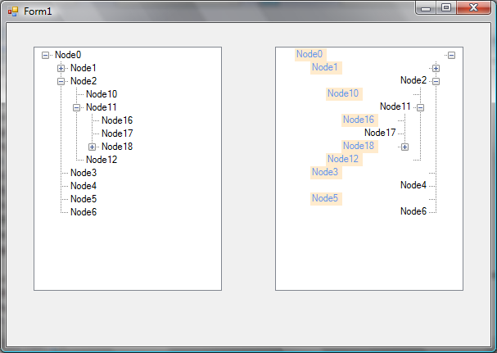
Bug in the .NET Framework TreeView Control
Passed onto the Winforms Team in China

Slide 42
Content Structure
About the Company
Background Information
Problem Statement
The Solution
Other Work Done
Learning from the Internship
References

Slide 43
Lessons Learnt
A lot of effort goes into making production-ready, bug-free software.
Extensible and reusable software boosts developer productivity: classes, generic methods
Coupling is the enemy of reusability in Object Oriented Software development.
A code management software gives peace of mind while coding.
Knowledge retention and transfer is very important from a software company’s perspective.
Software engineering is applied in the real world!

Slide 44
Content Structure
About the Company
Background Information
Problem Statement
The Solution
Other Work Done
Learning from the Internship
References

Slide 45
References
[1] G. G. Robertson, M.P. Czerwinski and J.E. Churchill, “Visualization of Mappings between Schemas”, in Proceedings of the SIGCHI Conference on Human Computer Interaction. [Online] Available: http://se-pubs.dbs.uni-leipzig.de/files/Robertson2005VisualizationofMappings.pdf. [Accessed: May 25, 2009]
[2] Microsoft in Wikipedia, The Free Encyclopedia [Online]. Available: http://en.wikipedia.org/wiki/Microsoft. [Accessed: Aug 9, 2009]
[3] Biztalk in Wikipedia, The Free Encyclopedia [Online]. Available: http://en.wikipedia.org/wiki/Biztalk. [Accessed: Aug 9, 2009]
[4] D. Chappel, “Introducing Biztalk Server 2009”, March 2009. [Online] Available: http://www.microsoft.com/biztalk/en/us/overview.aspx. [Accessed: May 19, 2009]
[5] Microsoft Corp., “About Biztalk Mapper”, March 2009. [Online] Available: http://technet.microsoft.com/en-us/library/ee251286(BTS.10).aspx. [Accessed: May 20, 2009]
[6] XML in Wikipedia, The Free Encyclopedia [Online]. Available: http://en.wikipedia.org/wiki/XML. [Accessed: Aug 9, 2009]
[7] XML Schema (W3C) in Wikipedia, The Free Encyclopedia [Online]. Available: http://en.wikipedia.org/wiki/XML_Schema_(W3C). [Accessed: Aug 9, 2009]
[8] XSLT in Wikipedia, The Free Encyclopedia [Online]. Available: http://en.wikipedia.org/wiki/XSLT. [Accessed: Aug 9, 2009]

Slide 46
Any Questions???

Slide 47
Thank You.

Slide 48
Extra Slides

Slide 49
Content Structure
Internship Goals
About the Company
Background Information
Problem Statement
Solution
Other Work Done
Learning from the Internship
References

Slide 50
Internship Goals
To see and experience how real world software development takes place
To understand the systems and processes that ensure software quality in a large organization like Microsoft
To achieve objectives set by the mentor and manager in a time bound and accountable manner.
To provide value to the company by applying the skills learnt in college in the real world – on shipping software.
To gain new development skills in the process of working with experienced engineers.

